Slide 1
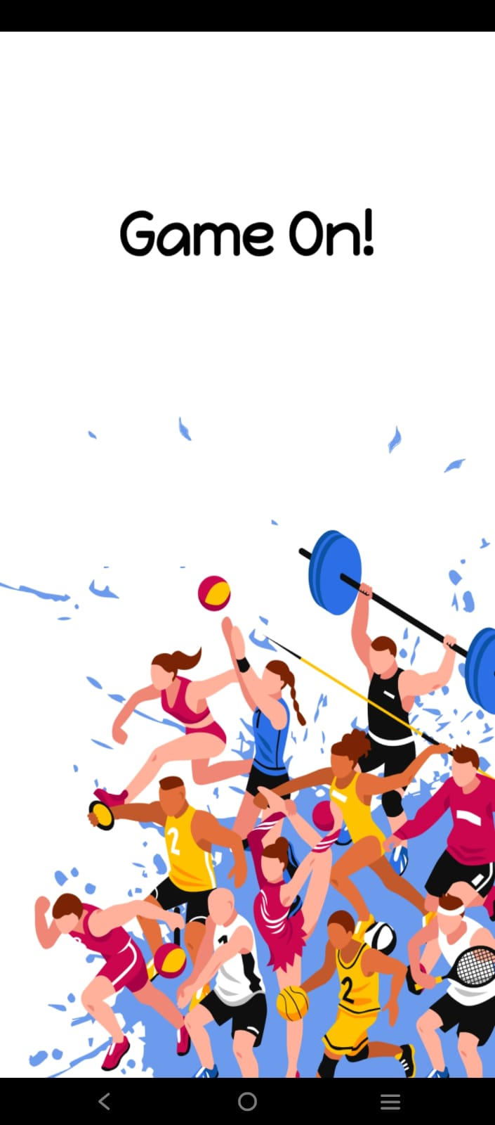

The Welcome screen is the first
screen of our app.
The user can click anywhere on the screen
to proceed.

Slide 2
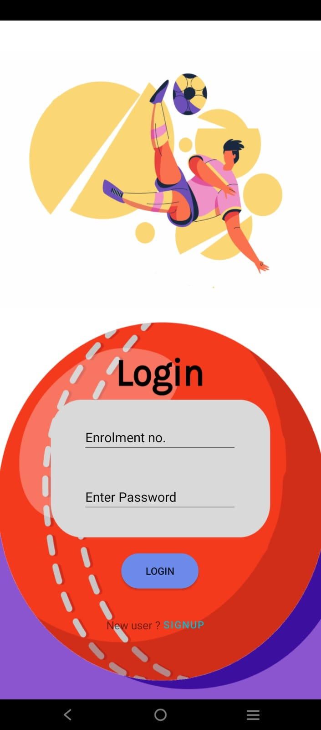
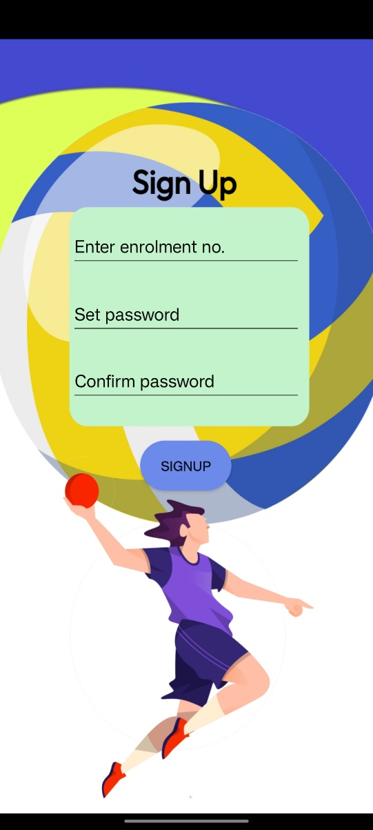
This screen will be the login screen of
our application.
If you are a new user you can
click on Signup to register.

Slide 3
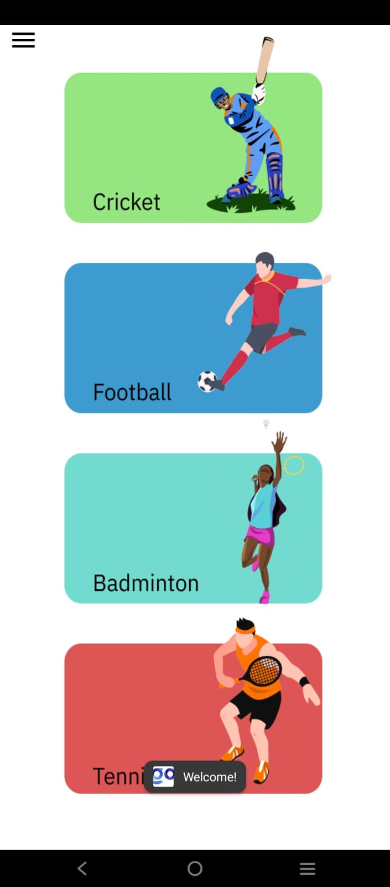
User can select any sporting facility of
their choice on this screen.

Slide 4
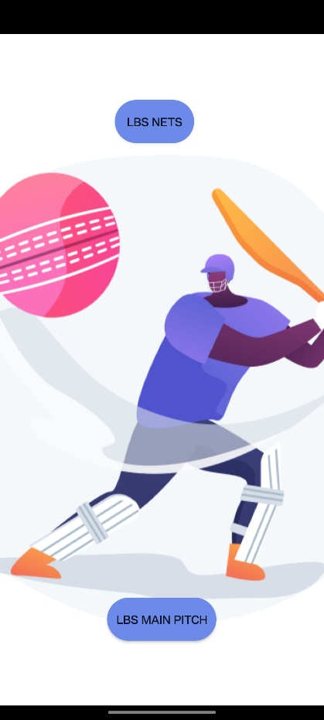
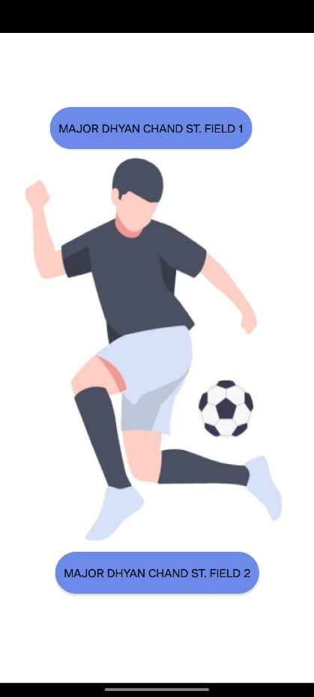
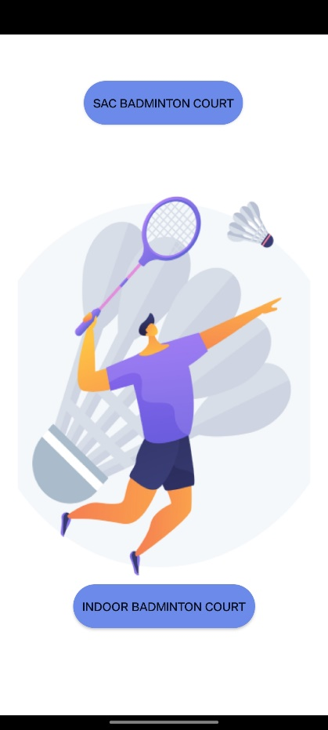
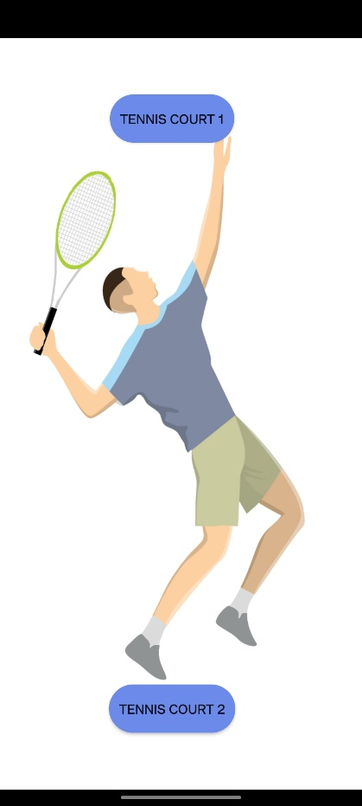
These are the different sport
facilities user can book.

Slide 5
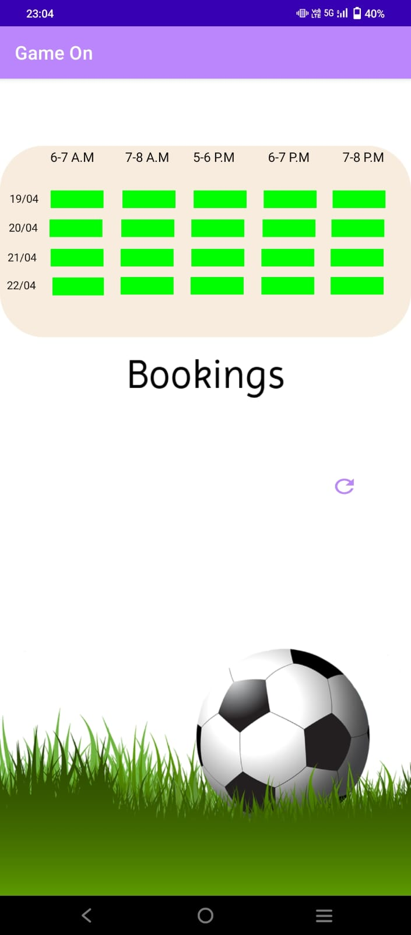
This grid allows you to book various time slots for any sport you want to book.

Slide 6
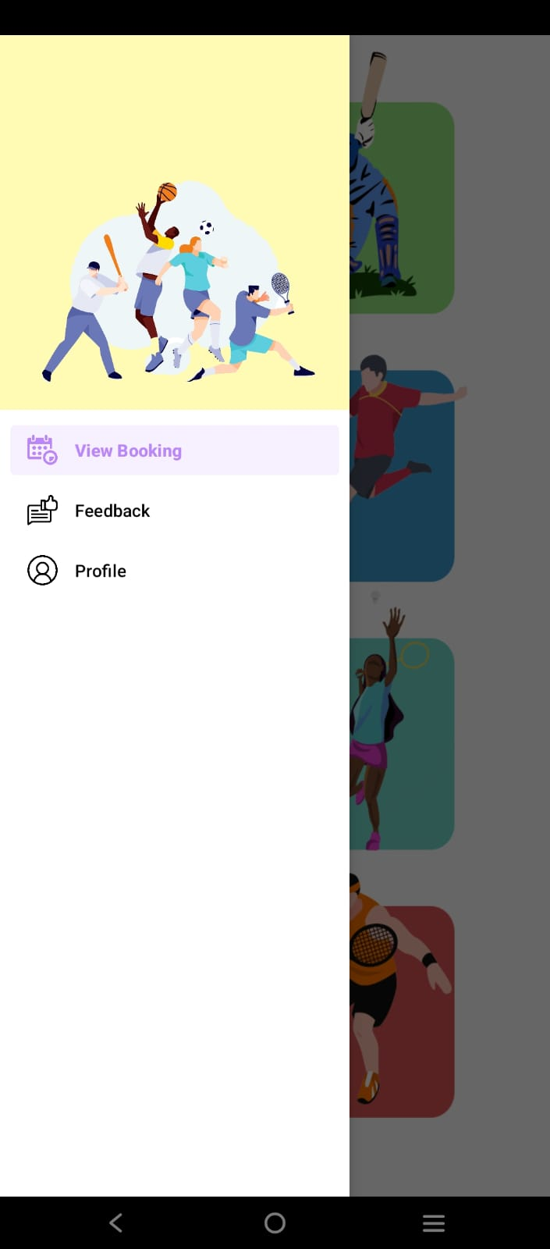
This will be the tool bar section which can be access from the top left corner of the screen.
From here user can access various features
of the application.

Slide 7
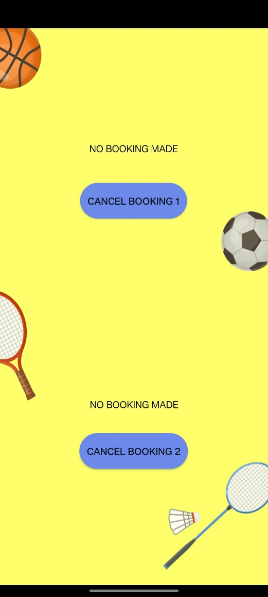
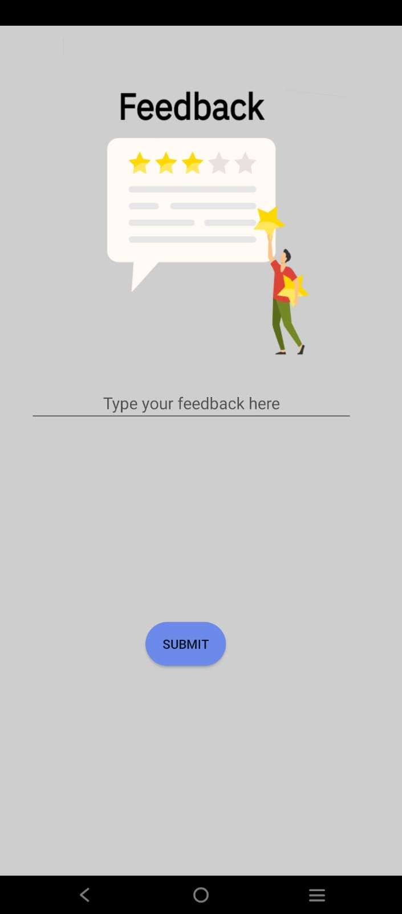
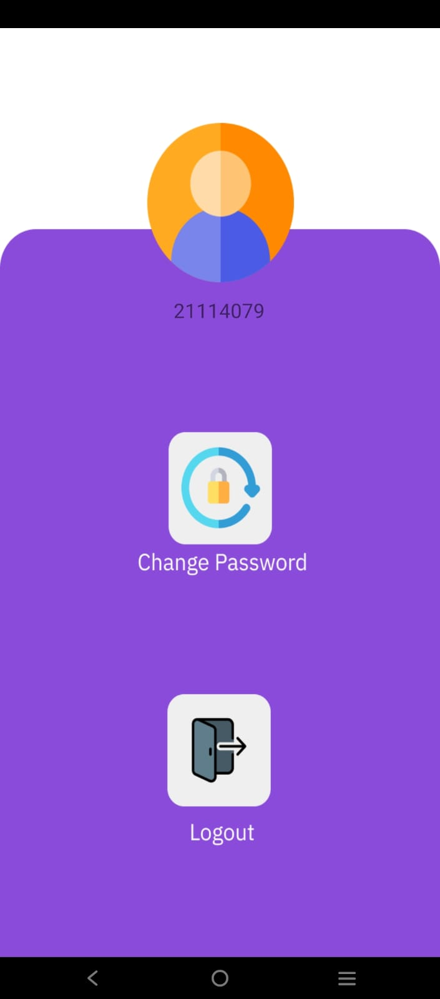
User can give their feedback based on the specific facility
Here the user can view the bookings they have made.
In this profile section user can
change password and logout

Slide 8
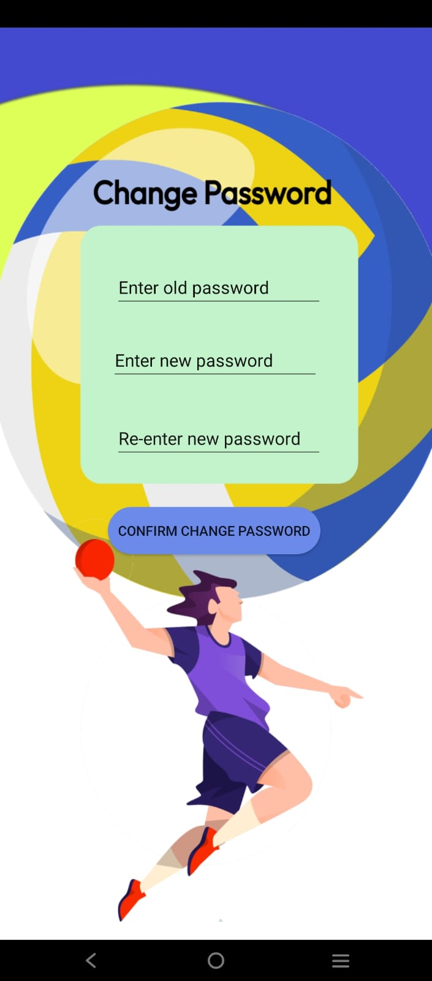
User can change their password
After selecting the “Change Password”
option present the profile section.

Slide 9
Piyush Arya: p_arya@cs.iitr.ac.in Mob. No.- 9116916870 Enrollment No. – 21117074
Contribution - Backend and Realtime database linking
Pranavdeep Singh: p_singh2@cs.iitr.ac.in Mob. No.- 8920582347 Enrollment No. – 21119036
Contribution – Backend and Realtime database linking
Priyansh Mawal: p_mawal@cs.iitr.ac.in Mob. No. – 6378146484 Enrollment No. - 21114076
Contribution – UI Design
Priyanshu Behera: p_behera@cs.iitr.ac.in Mob. No. – 9340371238 Enrollment No. - 21114077
Contribution – UI Design
Rajat Raj Singh: r_rsingh@cs.iitr.ac.in Mob. No. – 8218516522 Enrollment No. - 21114079
Contribution – Backend and Real-time database linking
Atharv Chhabra: a_chhabra@cs.iitr.ac.in Mob. No.- 6260888533 Enrollment No. - 21118025
Contribution - UI Design

